Slide 1
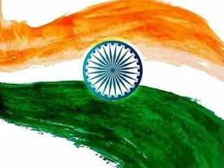

ELECTION RESULT ANALYSIS 2024
Presented by
FATHIMA DILSHANA PK

Slide 2
TABLE OF CONTENT
PROJECT OVERVIEW
DATA DESCRIPTION
POWER BI VISUALIZATION
INSIGHTS
RECOMMENDATIONS

Slide 3
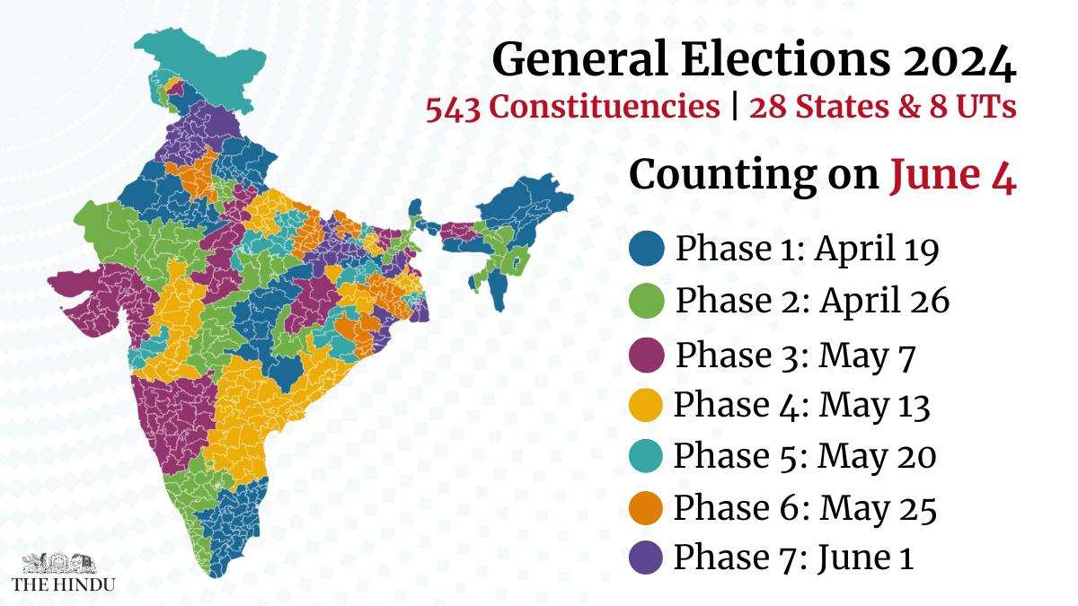
PROJECT OVERVIEW
Indian elections are a vital aspect of the world's largest democracy, reflecting the political will and societal trends of a diverse population. The 2024 general elections, conducted on April 2024, are crucial as they determine the leadership and direction of the country for the next five years. Understanding the election data provides valuable insights into voter behavior, regional political dynamics, and the overall health of the democratic process in India.
This project aims to analyze the 2024 Indian election data to gain insights into election results, party performance, and voter trends across various constituencies. Using Power BI, we will create interactive visualizations and dashboards to help stakeholders understand the election outcomes and the dynamics between different political alliances. The analysis includes calculating the average vote margin for different constituencies within each state and visualizing this data using card visuals, tables, and slicers for enhanced interactivity.

Slide 4
DATA DESCRIPTION
1. Election Results Data:
_id: Unique identifier for each record.
State: Name of the state where the election was held.
Const. No.: Constituency number.
Constituency: Name of the constituency.
Leading Candidate: Name of the candidate leading in the election.
Leading Party: Name of the party of the leading candidate.
Trailing Candidate: Name of the candidate trailing in the election.
Trailing Party: Name of the party of the trailing candidate.
Margin: Vote margin between the leading and trailing candidates.
Status: Status of the election result (e.g., Won, Lost, Leading, Trailing).
2. Party Alliance Data:
Party Name: Name of the political party.
Alliance Name: Name of the political alliance to which the party belongs.

Slide 5
POWER BI VISUALIZATION
I merged the election results and party alliance datasets to identify the winning and trailing alliances, resulting in two new datasets. A new measure was created to calculate the average margin of votes and a new column was added to compute the number of seats won, which was then used to calculate the total number of seats won by each party.
In my visualization, I created with two dashboards. One is based on party name , state and constituency. The other one is based on party alliances. Six slicers were created for state , constituency, party and result status. Two tables were developed : one showing leading party, state , margin of votes , and constituency, and another with trailing party, state, margin of votes and constituency.
Key Performance Indicators(KPIs) were added to display leading candidates by leading party and total seats won by party per state. A card showing the average margin of votes, a map highlighting states and leading parties, a matrix showing the leading party by the total number of constituencies, and a stacked column chart displaying trailing and leading parties by their respective states were also included.

Slide 6
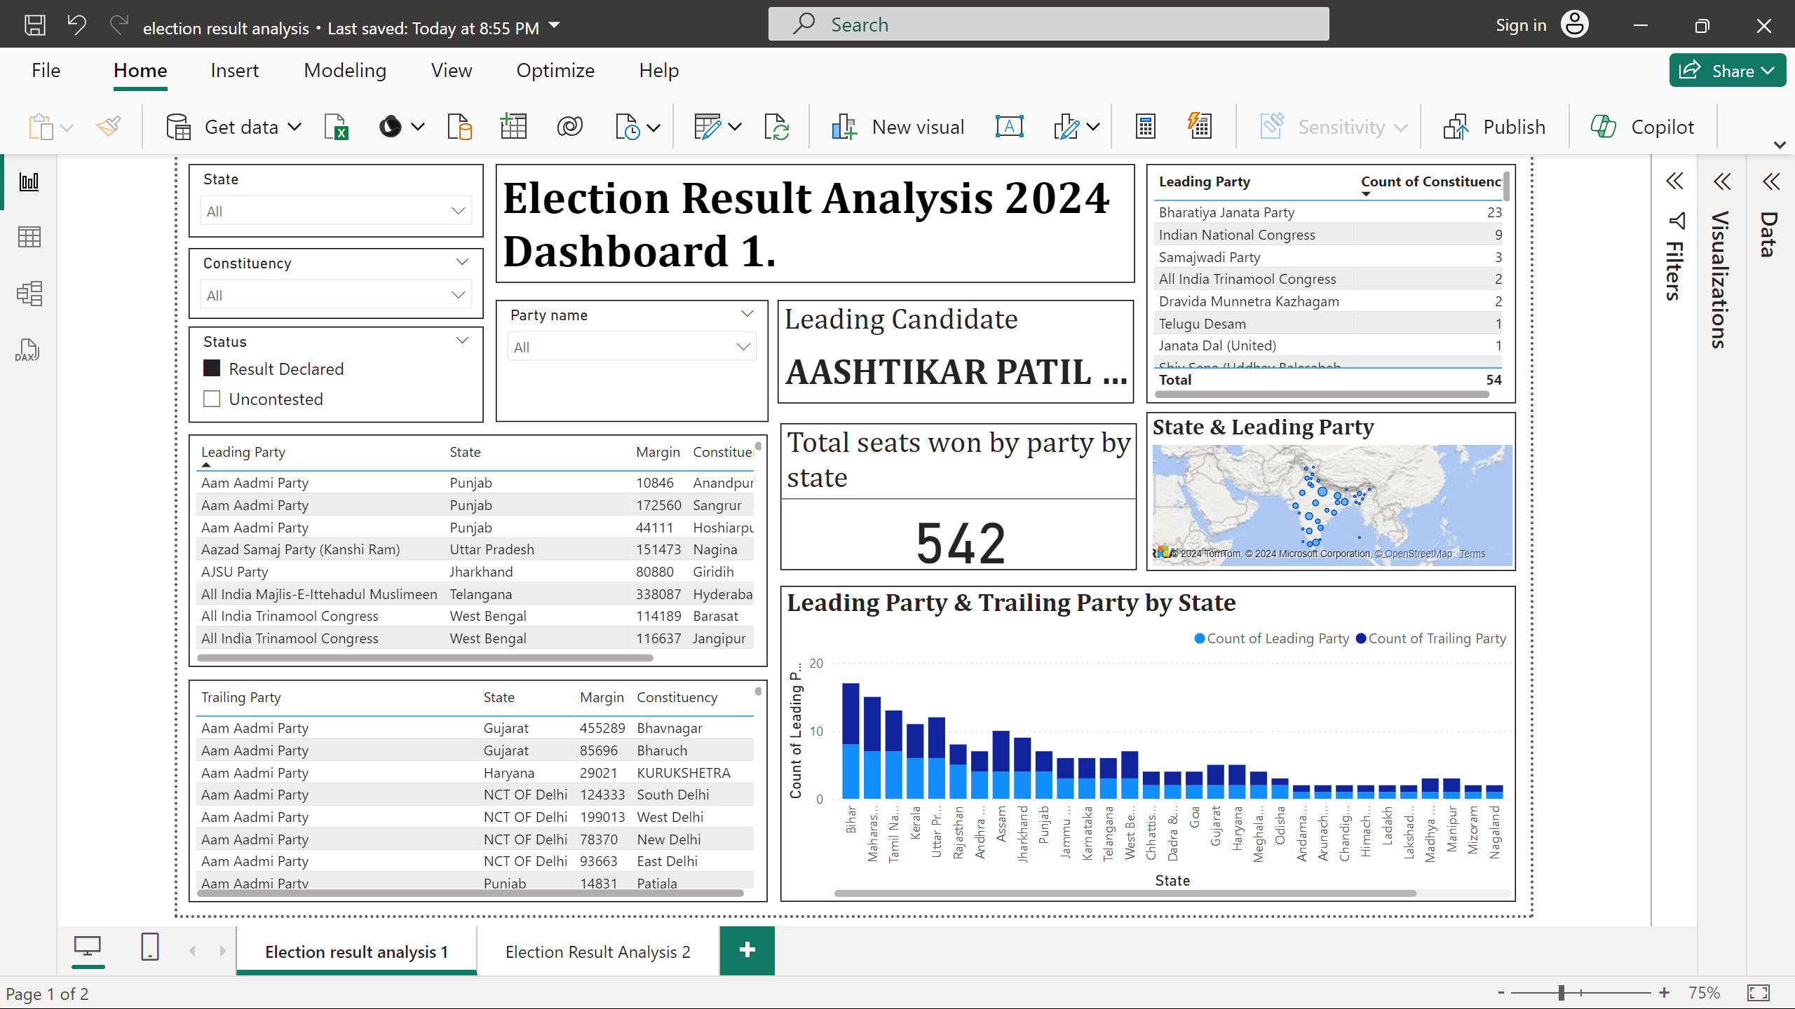

Slide 7
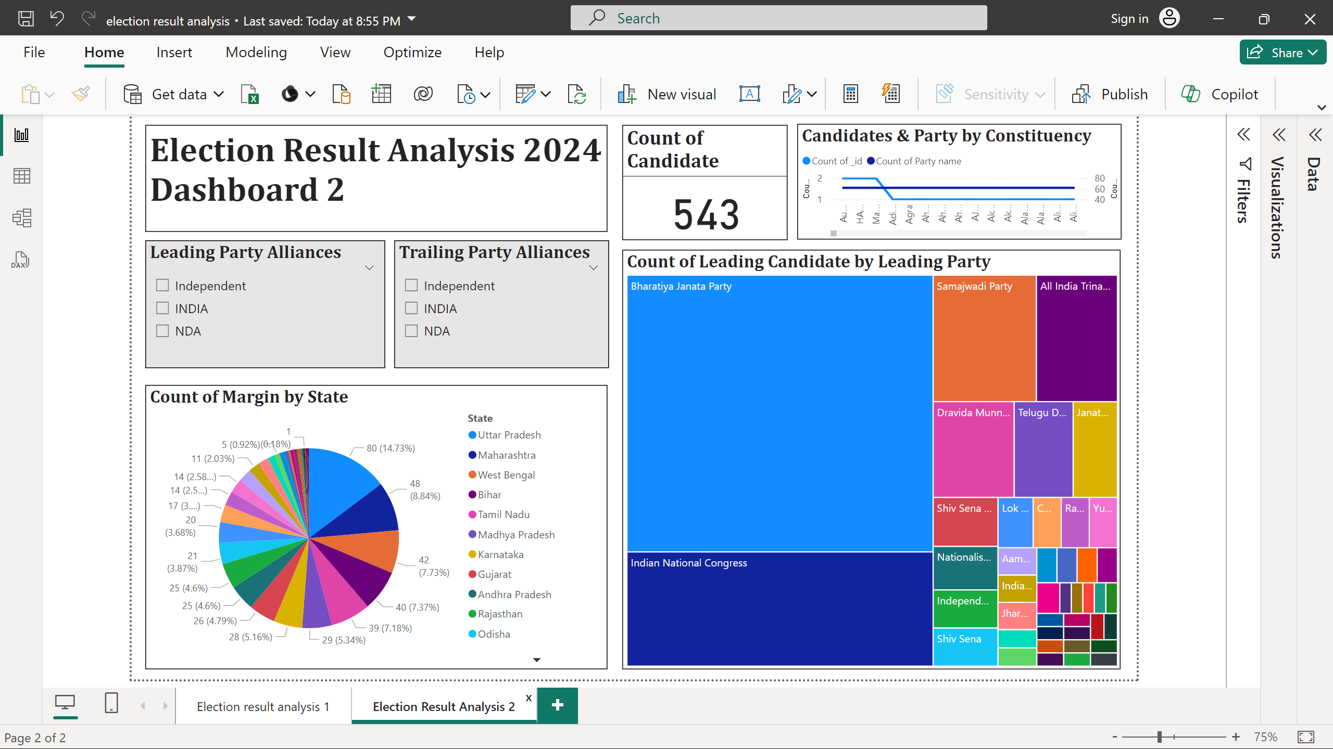

Slide 8
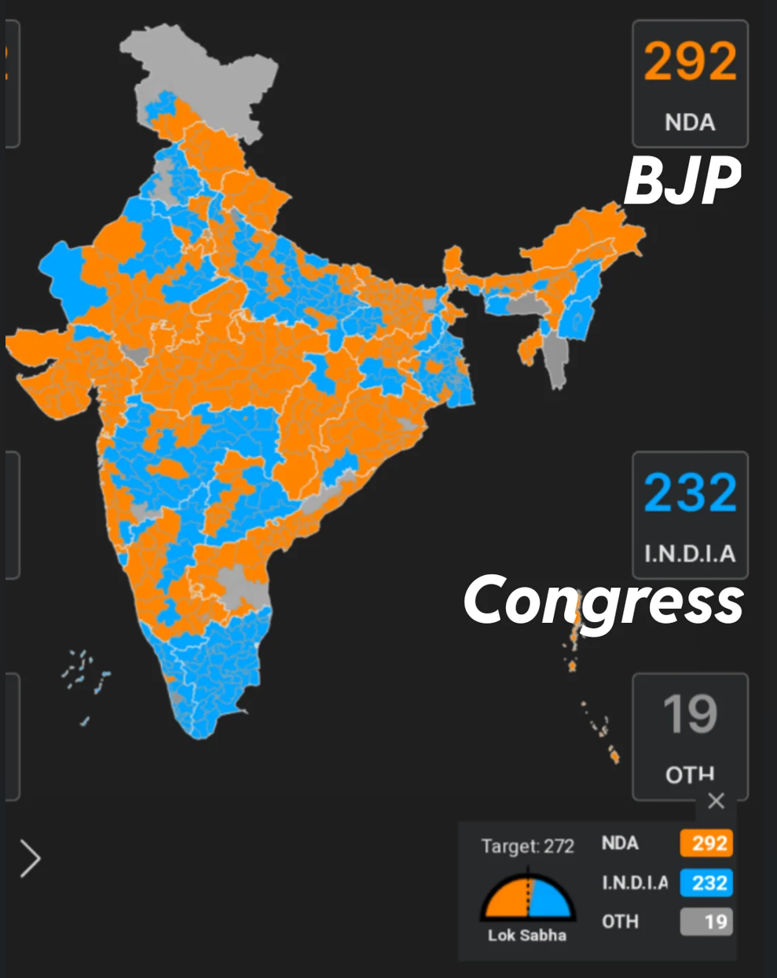
INSIGHTS
The election results analysis highlights several critical points.
Certain political parties and alliances secured the most seats, demonstrating strong voter support.
State-wise, clear preferences for specific parties suggest strong regional leadership and loyalty.
Competitive states with smaller average margins indicate fierce contests.
Swing constituencies, with their narrow margins, are pivotal for future elections.
Comparing parties and alliances reveals their electoral strength and voter appeal, while trend analysis identifies regions with high competition and areas dominated by specific parties.

Slide 9
RECOMMENDATIONS
To improve future performance, parties should focus on swing constituencies with narrow margins, increasing resources and local engagement to secure these areas.
Strengthening presence in competitive states through strategic planning and addressing regional issues can also yield gains.
Parties should maintain and strengthen their strongholds by engaging continuously with voters.
Effective collaboration within alliances should continue, leveraging shared resources and unified strategies.
Lastly, using data-driven strategies to monitor voter behavior and trends can provide actionable insights for adapting strategies dynamically during election campaigns.

Slide 10
THANK YOU

